Slide 1
PortKey
Travel Made
EZ
CSP203 Project Group7

Slide 2

Why PortKey?
Idea : IRCTC type portal for buses and cabs.
Problem : The dynamic nature of their schedules.
Solution : On the fly information about the status of buses using drivers mobile, sharing of cabs when desired.

Slide 3
Part A - Sharing of Cabs!
The idea was to help users reduce the price for their travel.
“Pools” in this application were created to show an entity that corresponded to a cab that’s travelling to a particular place on a particular time.
Users are provided with the functionality of Creation of pools, Getting info of the pools and their registration in a pool.

Slide 4
Part B - Keeping track of Buses
The idea was to help users reduce the pain waiting for buses at a bus stand causes.
In this part of our application, we created interfaces for both the driver and the customer.

Slide 5
Driver
The location of driver was updated after a certain amount of time and was stored in our database.
His destination was already stored in our database.
With the info gathered, travel time and distance was calculated.

Slide 6
Customer
The customer logs into our application and is shown the information regarding all the buses.
This information includes the destination, bus no., and colour.
According to his preference, the user can select the bus he wants to track and he’ll be directed to a page that contains the information calculated before.

Slide 7

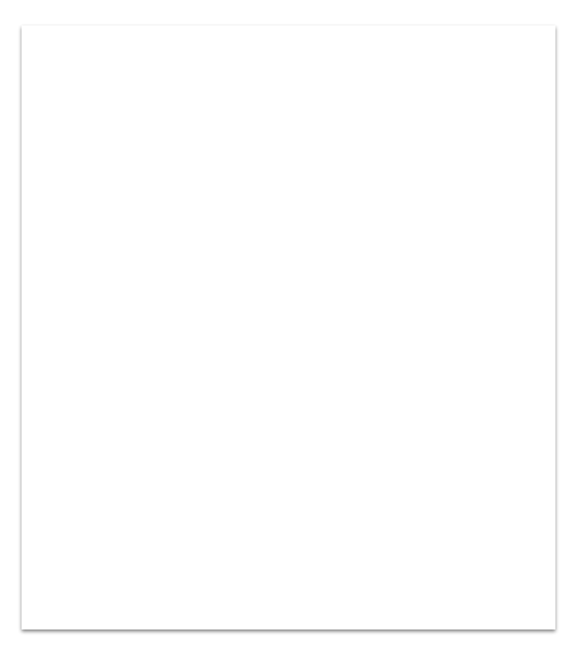
APIs Used
Google Places
Google Maps GeoCoding
Google Maps Javascript
Google Maps Distance Matrix
Google Maps GeoLocation
Tip
In this example, we’re leading off with something unexpected.
While the audience is trying to come up with a number, we’ll surprise them with the next slide.

Slide 8
Made by :-
Divjot Singh
Rohit Malik
Chintala Tejaswini
Shreyans Soni
Tip
Remember. If something sounds like common sense, people will ignore it.
Highlight what is unexpected about your topic.

Slide 9
Questions?

